Slide 1
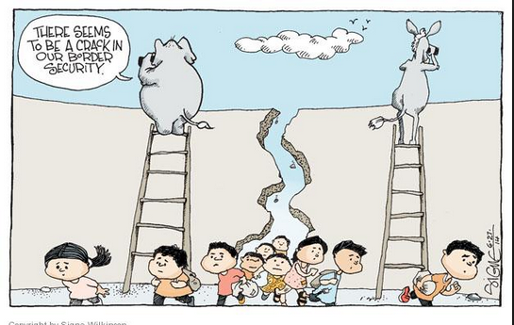
Border Security/Immigration
Student’s Name
Institution

Slide 2
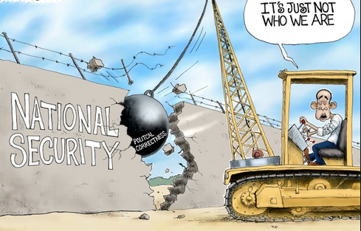
Introduction
A poll by Texas Lyceum was done to collect the views of people concerning border security
Many people in Texas accept local authorities to ask immigration status of the people
62% of Texas natives believe that border security helps America bolster its security
Notes:
Over 90% of people living in Texas consent that local police ought to be allowed to ask about a person’s immigration status when one is arrested for committing crime. This is in accordance to the poll results compiled by the Texas Lyceum in 2017(DeSipio, 2018)The poll focused on the issue of border security as well as state-based immigration efforts which are divisive issues for law makers in Texas. Half of Texans oppose the legislation of sanctuary policies whereby the police or other law enforcers are not allowed to report the undocumented immigrants to the federal authorities for their history in crime.

Slide 3
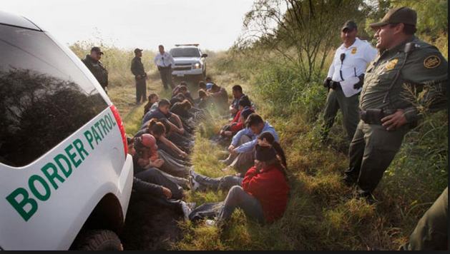
Texas Government
Pros of border security/Immigration
Economic security
The economy of the country becomes boosted
Provision of labor is increased in various job opportunities
The GDP of America is likely to increase
Notes:
Immigrants only eligible for legal status and not citizenship contribute to $832 billion towards the country’s economy. When the vast majority of the undocumented immigrants in America are granted citizenship the economy of the country is likely to increase. Therefore, the GDP of America is expected to increase by $1.4 trillion. Additionally, over 203,000 jobs have been created with the huge influx of immigrants which is exemplary on the economic state of the Texas (DOTY, 2018).

Slide 4
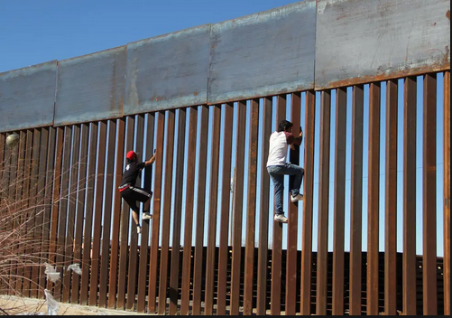
Border fence
President Trump has been on the forefront of building a border fence or wall
The wall will control undocumented entry of Mexicans into the borders of America
The issuance of legal documents to reside in America will come at an increased fee
Notes:
President Trump has championed the installation or a wall between America and Mexico. He emphasized that the motive of this border fence was to impound remittance payments which are resulting from illegal wages and increase fees on every border crossing cards (Izcara & Palacios, 2019). Furthermore, the border protection will have to increase fees every temporary visas which are given to Mexican CEOs as well as diplomats.

Slide 5
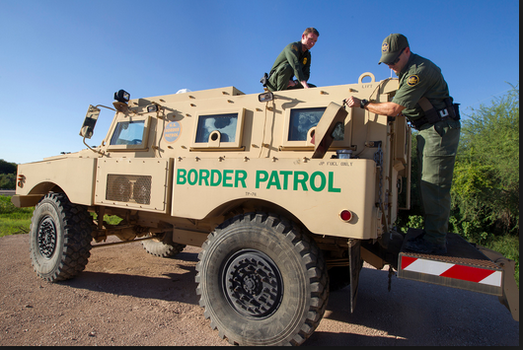
Cons: Disadvantages to the workers of America
Citizens of America living in Texas are likely to remain unemployed
Increased demand for the employment opportunities
Low payment in various sectors like in construction of buildings
Notes:
Immigrants usually increase the demand for job opportunities which puts lots of pressure on the natives of Texas who should get the employment vacancies (Zavaleta & Kaplan, 2018). Being that immigrants increase the population of Texas, there will be much pressure exerted on the limited job opportunities available. Hence most Americans are likely to remain unemployed due to the high competition for the slots by immigrants. That is, the vast majority of students completing their tertiary education to get employed are expected to remain jobless. Due to high demand for the few job vacancies, amounts of payment to workers is likely to reduce.

Slide 6
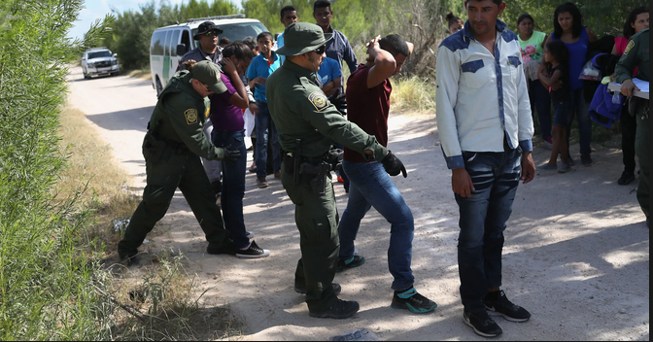
Higher Crime
The level of crime has increased in the state such as rape, murder and robbery
Increases in the influx of immigrants has dented security
FBI data indicate that crime rate in the state is on ascendency
Notes:
The foreign-born share of the U.S population grew from 7.9% to 13.1% between 1990 and 2013. Most importantly to note, the number of unofficial immigrants significantly increased from 3.5 million to 11.2 million. The data collected from FBI indicate that crime rate has increased over the years. For example, reported cases of robbery, rape, aggravated assault as well as murder have risen by 48% (Zavaleta & Kaplan, 2018). In addition, property crime rate has as well increased by 41%. Clearly this shows the importance of sanctuary policies which can be implemented to check criminal record of the immigrants..

Slide 7
References
DeSipio, L. (2018). US immigration in the twenty-first century: Making Americans, remaking America. Routledge.
DOTY, R. L. (2018). Divided Lines. Immigration and the Law: Race, Citizenship, and Social Control, 61.
Izcara & Palacios, S. P. (2019). Corruption at the Border: Intersections between US Labour Demands, Border Control, and Human Smuggling Economies. Antipode.
Zavaleta, A. N., & Kaplan, M. A. (2018). Immigrant Caging on the Texas-Mexico Border. Rio Grande Valley History, 341.

